Slide 1
Online CarService
TongWu
A20410395

Slide 2
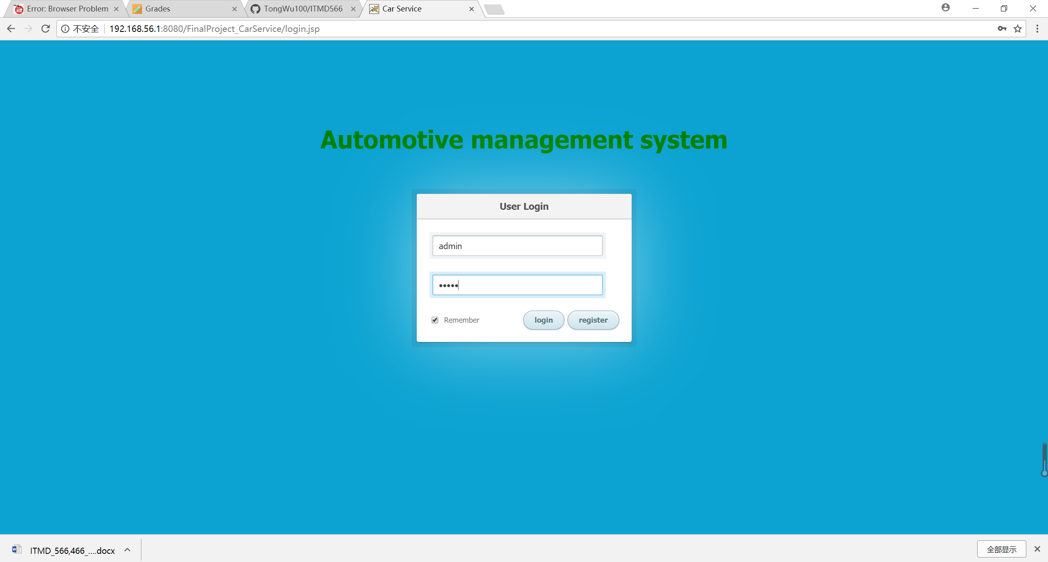
My app allows users to log in with two identities: Admin and Customer
Admin login

Slide 3
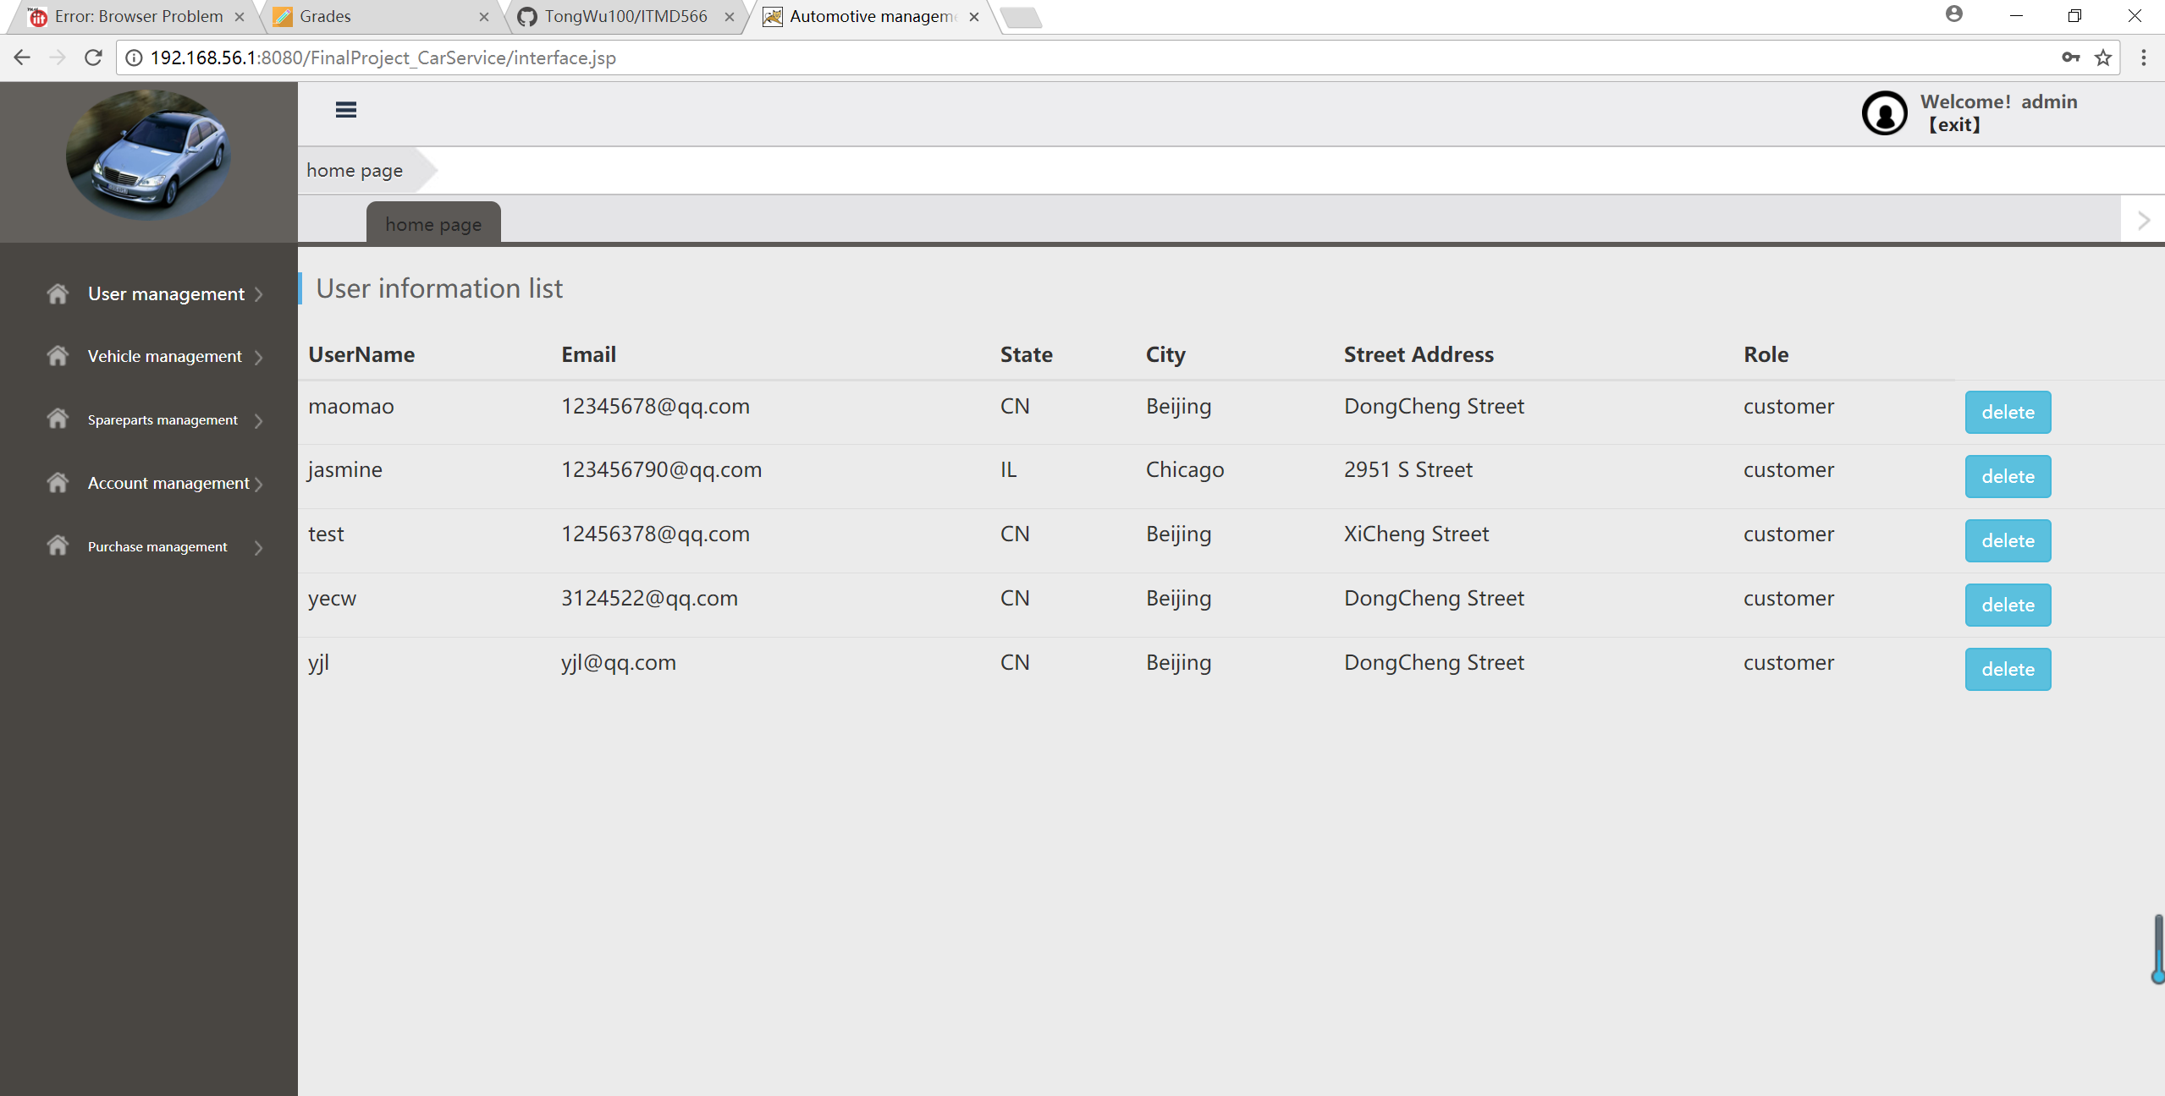
Admin check user information

Slide 4
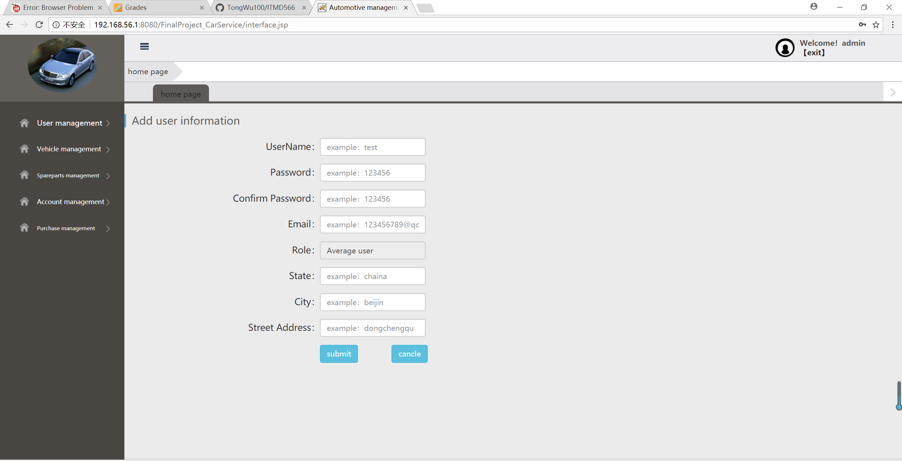
Admin add a new user

Slide 5
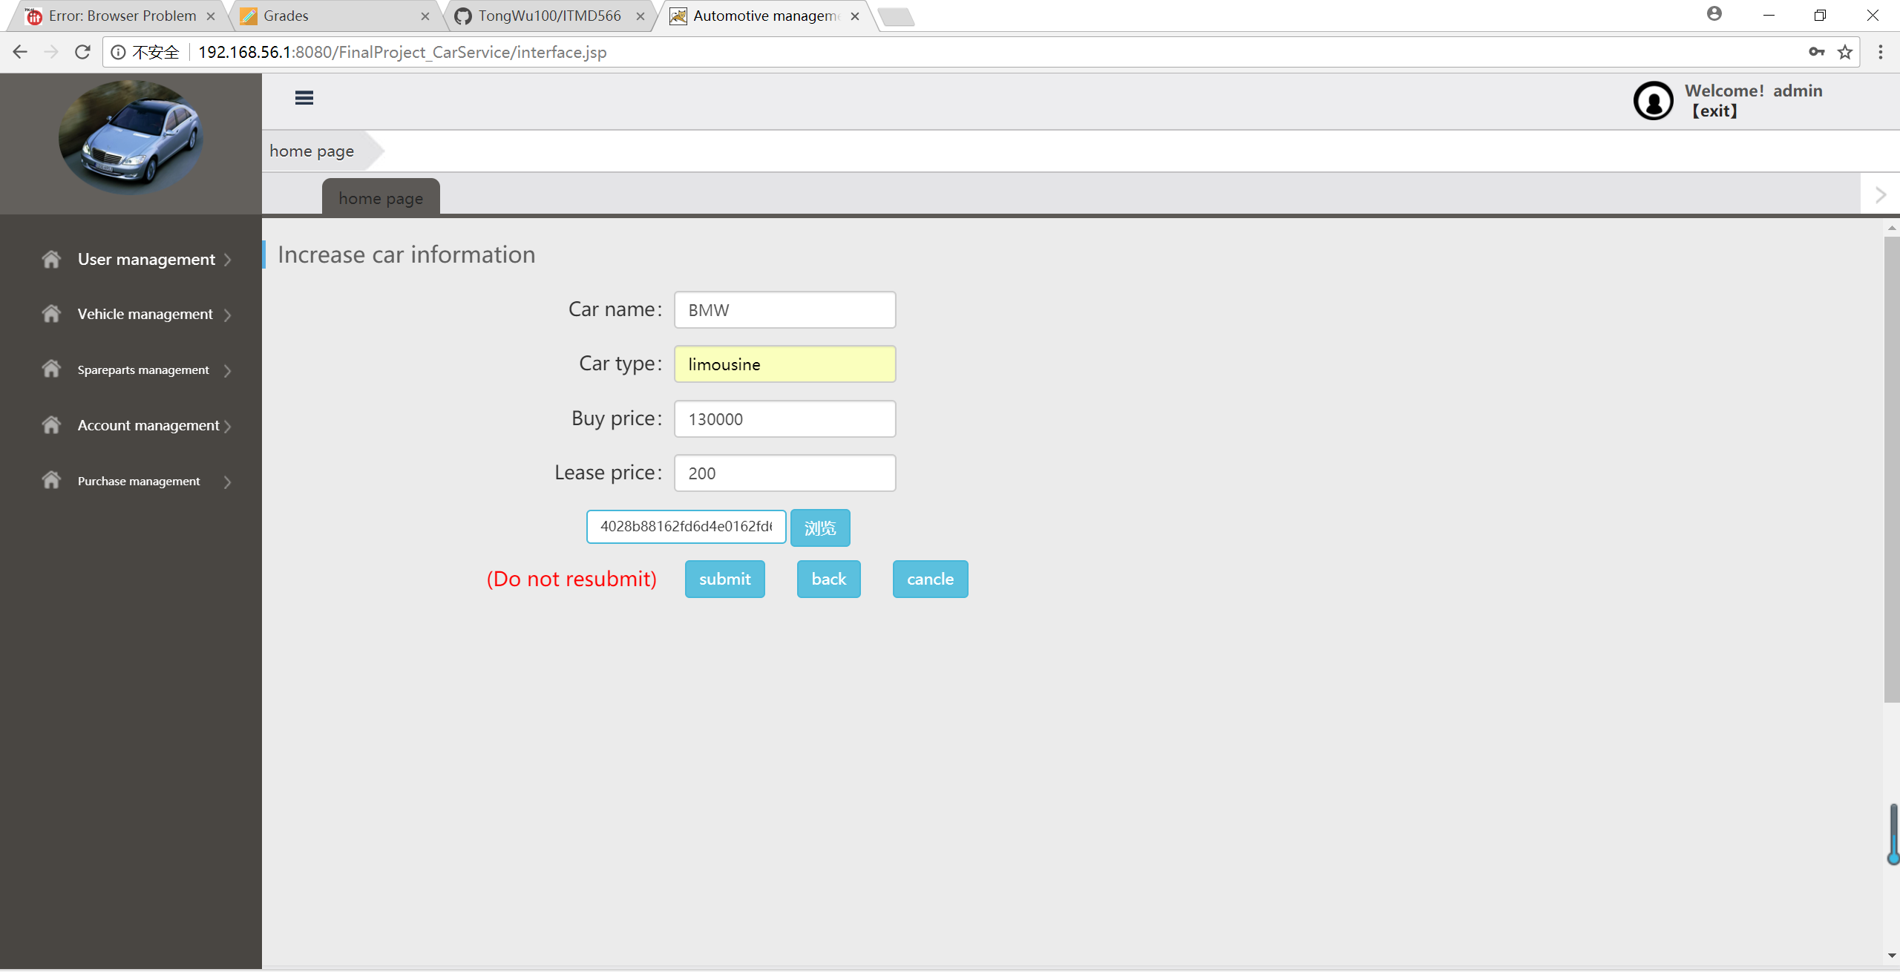
Admin add a new car

Slide 6
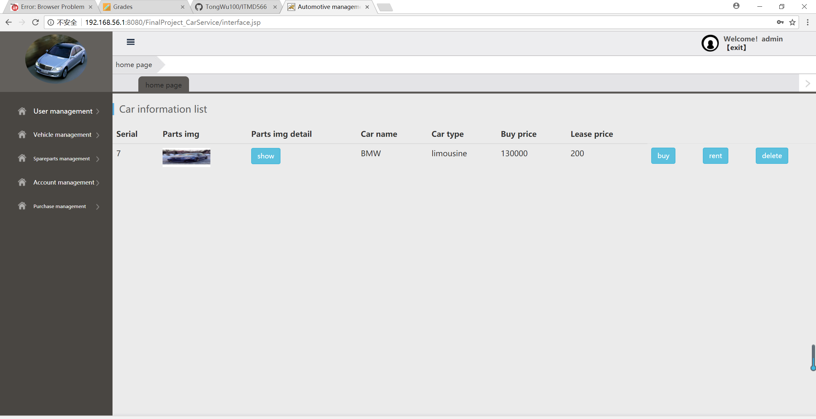
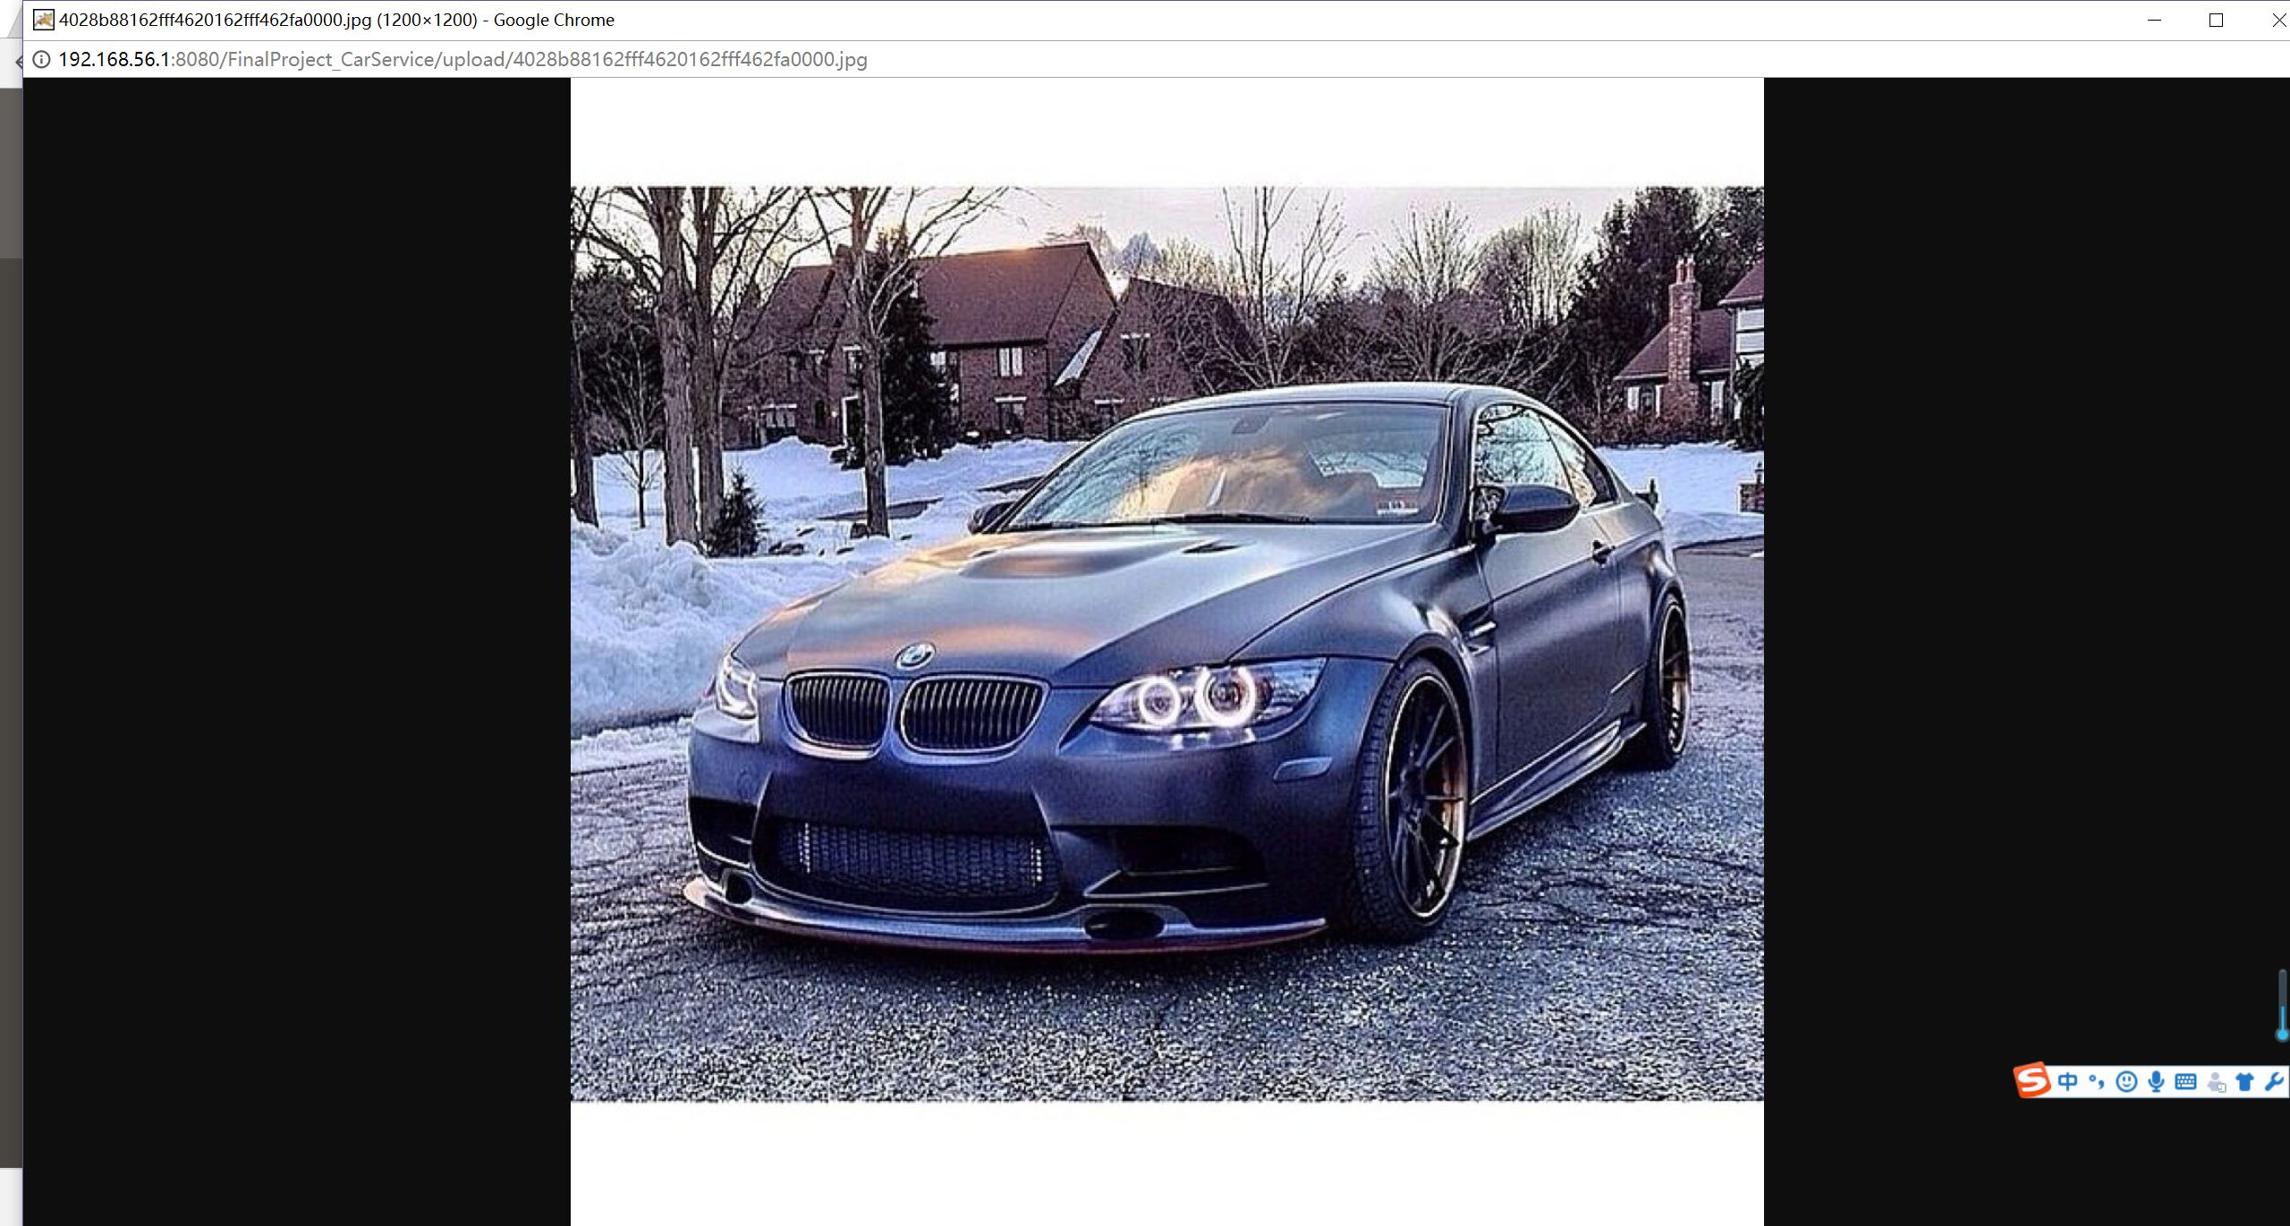
Admin check car information

Slide 7
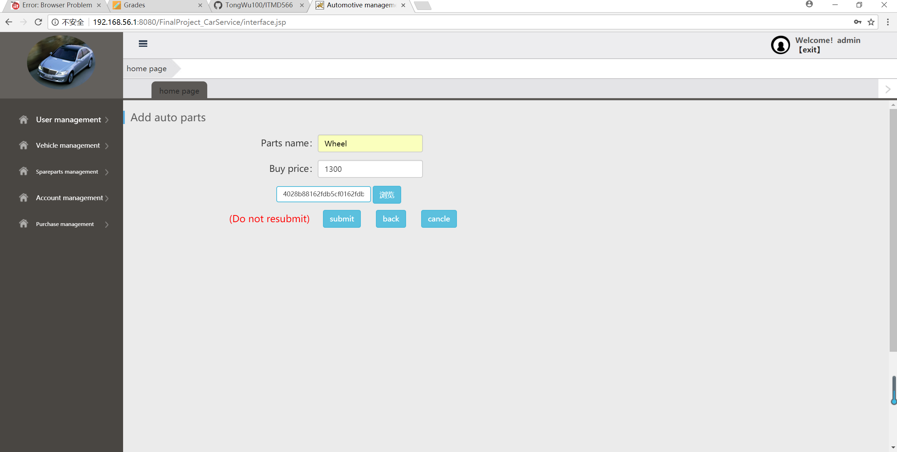
Admin add a new wheel

Slide 8
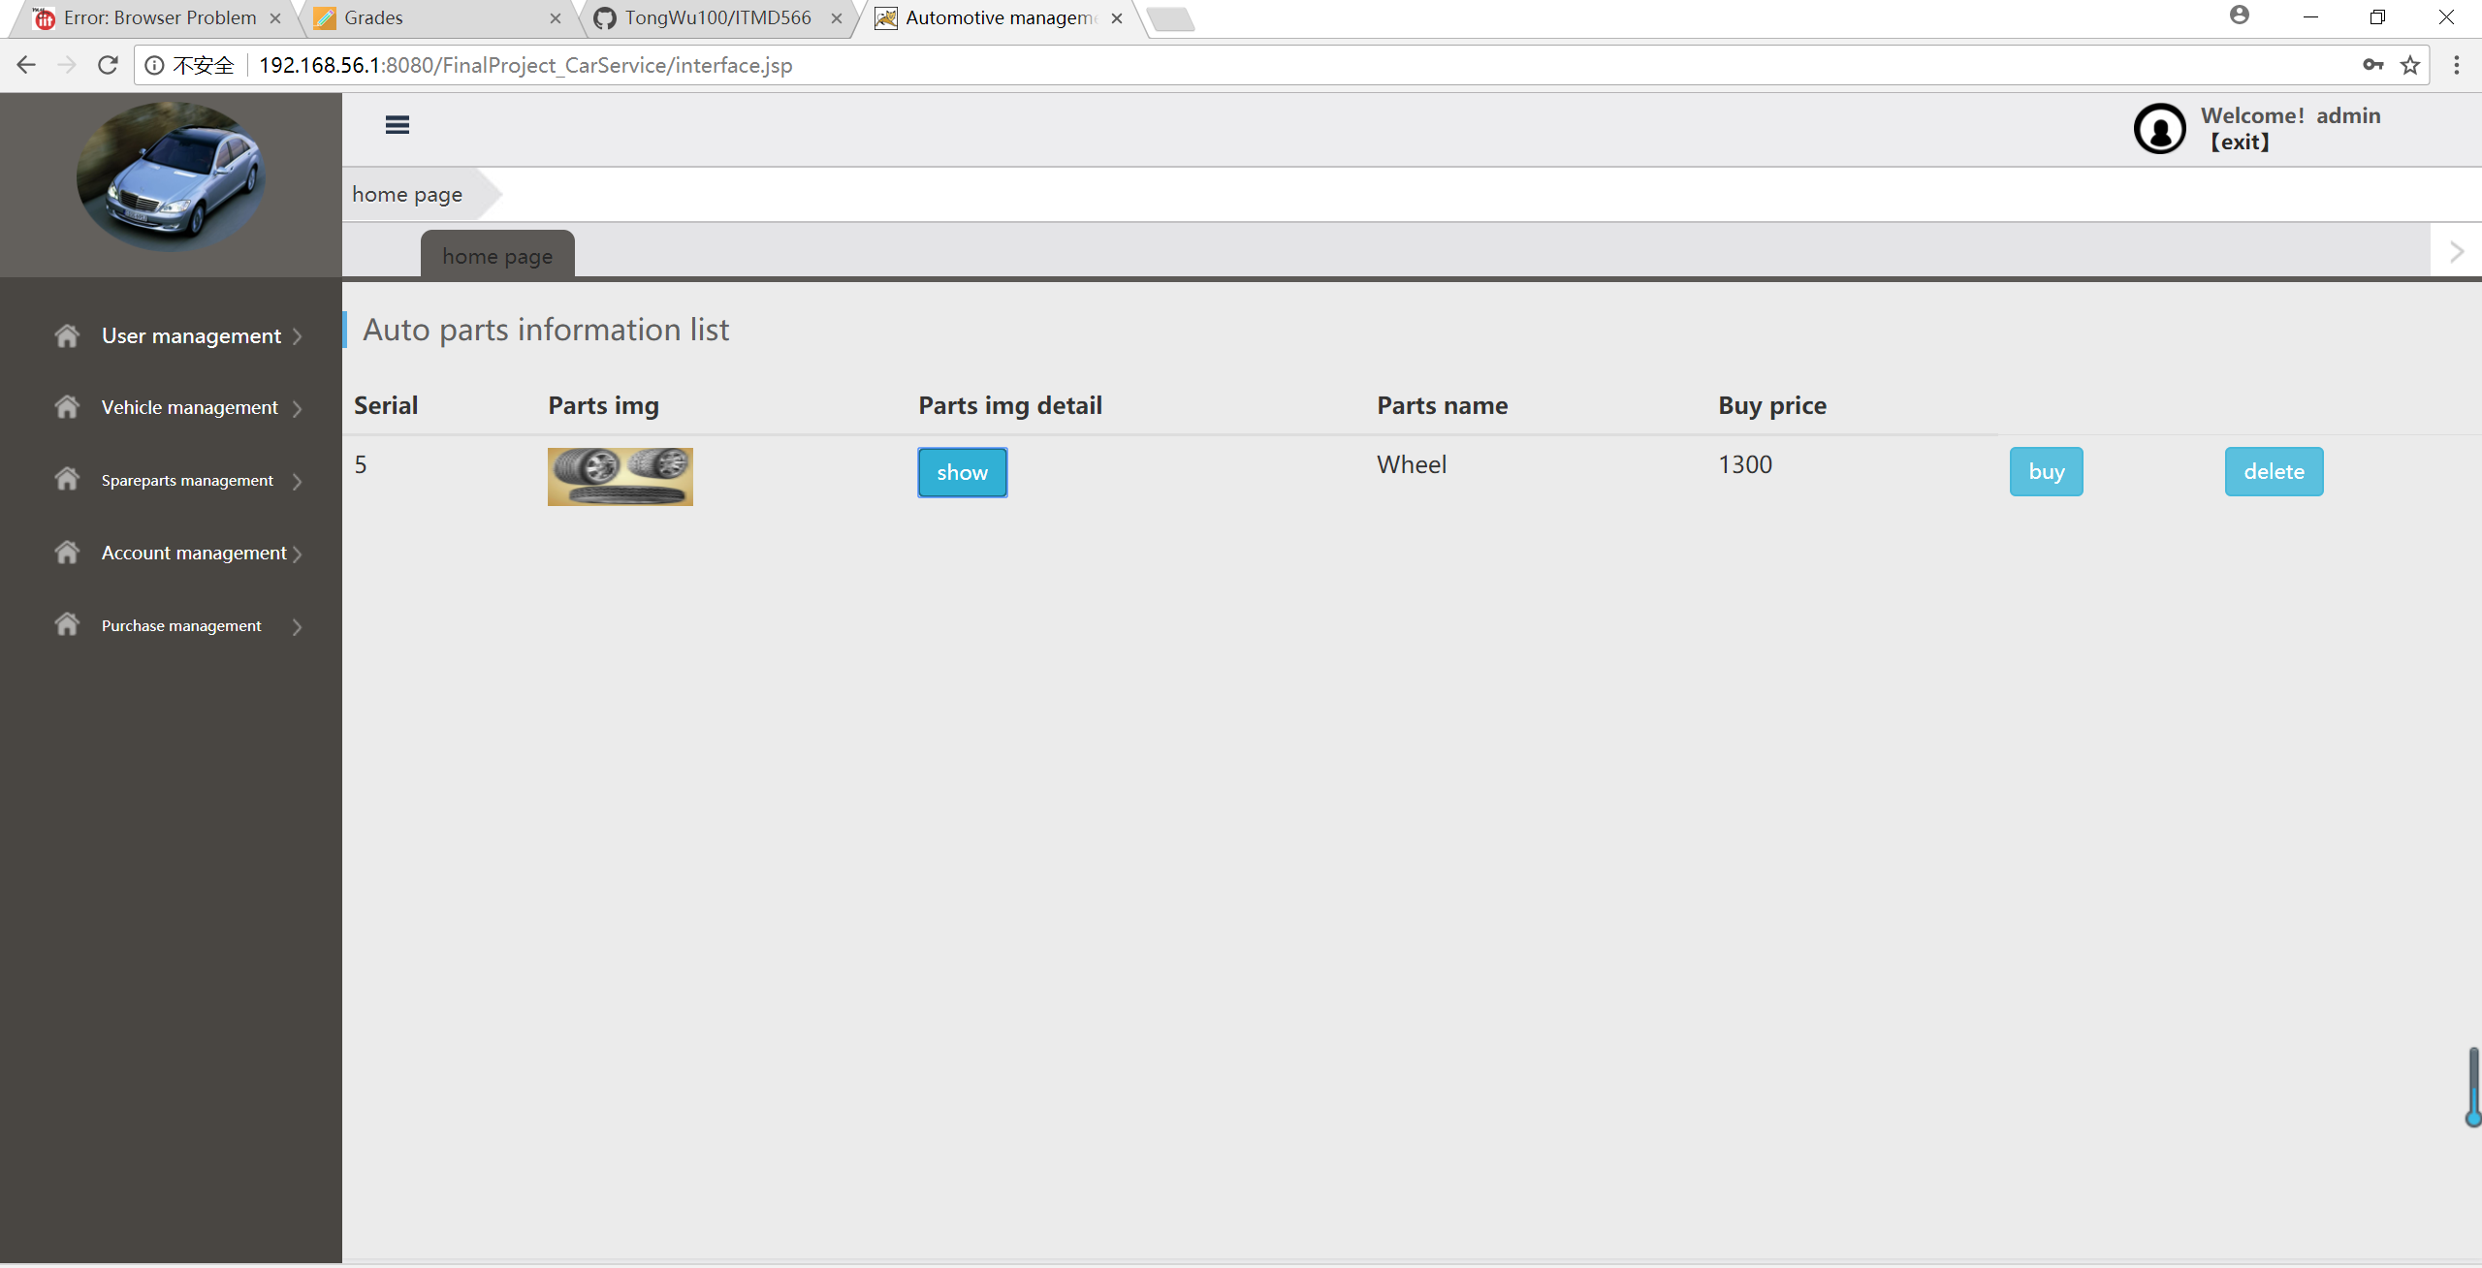
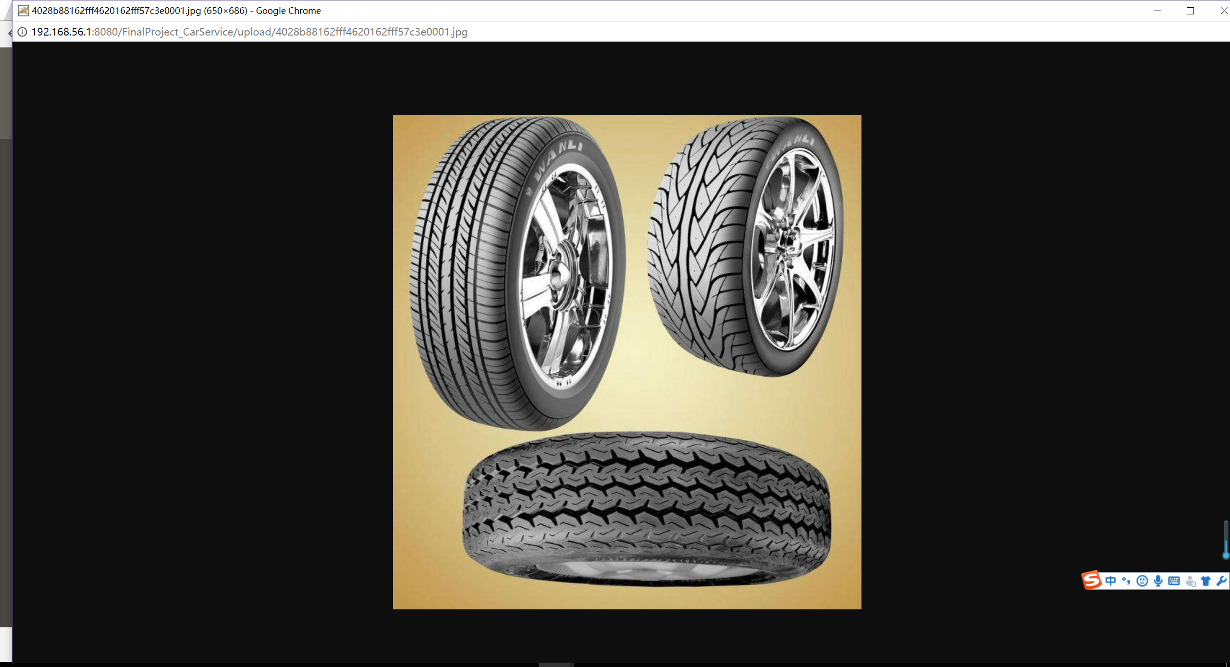
Admin check wheel information

Slide 9
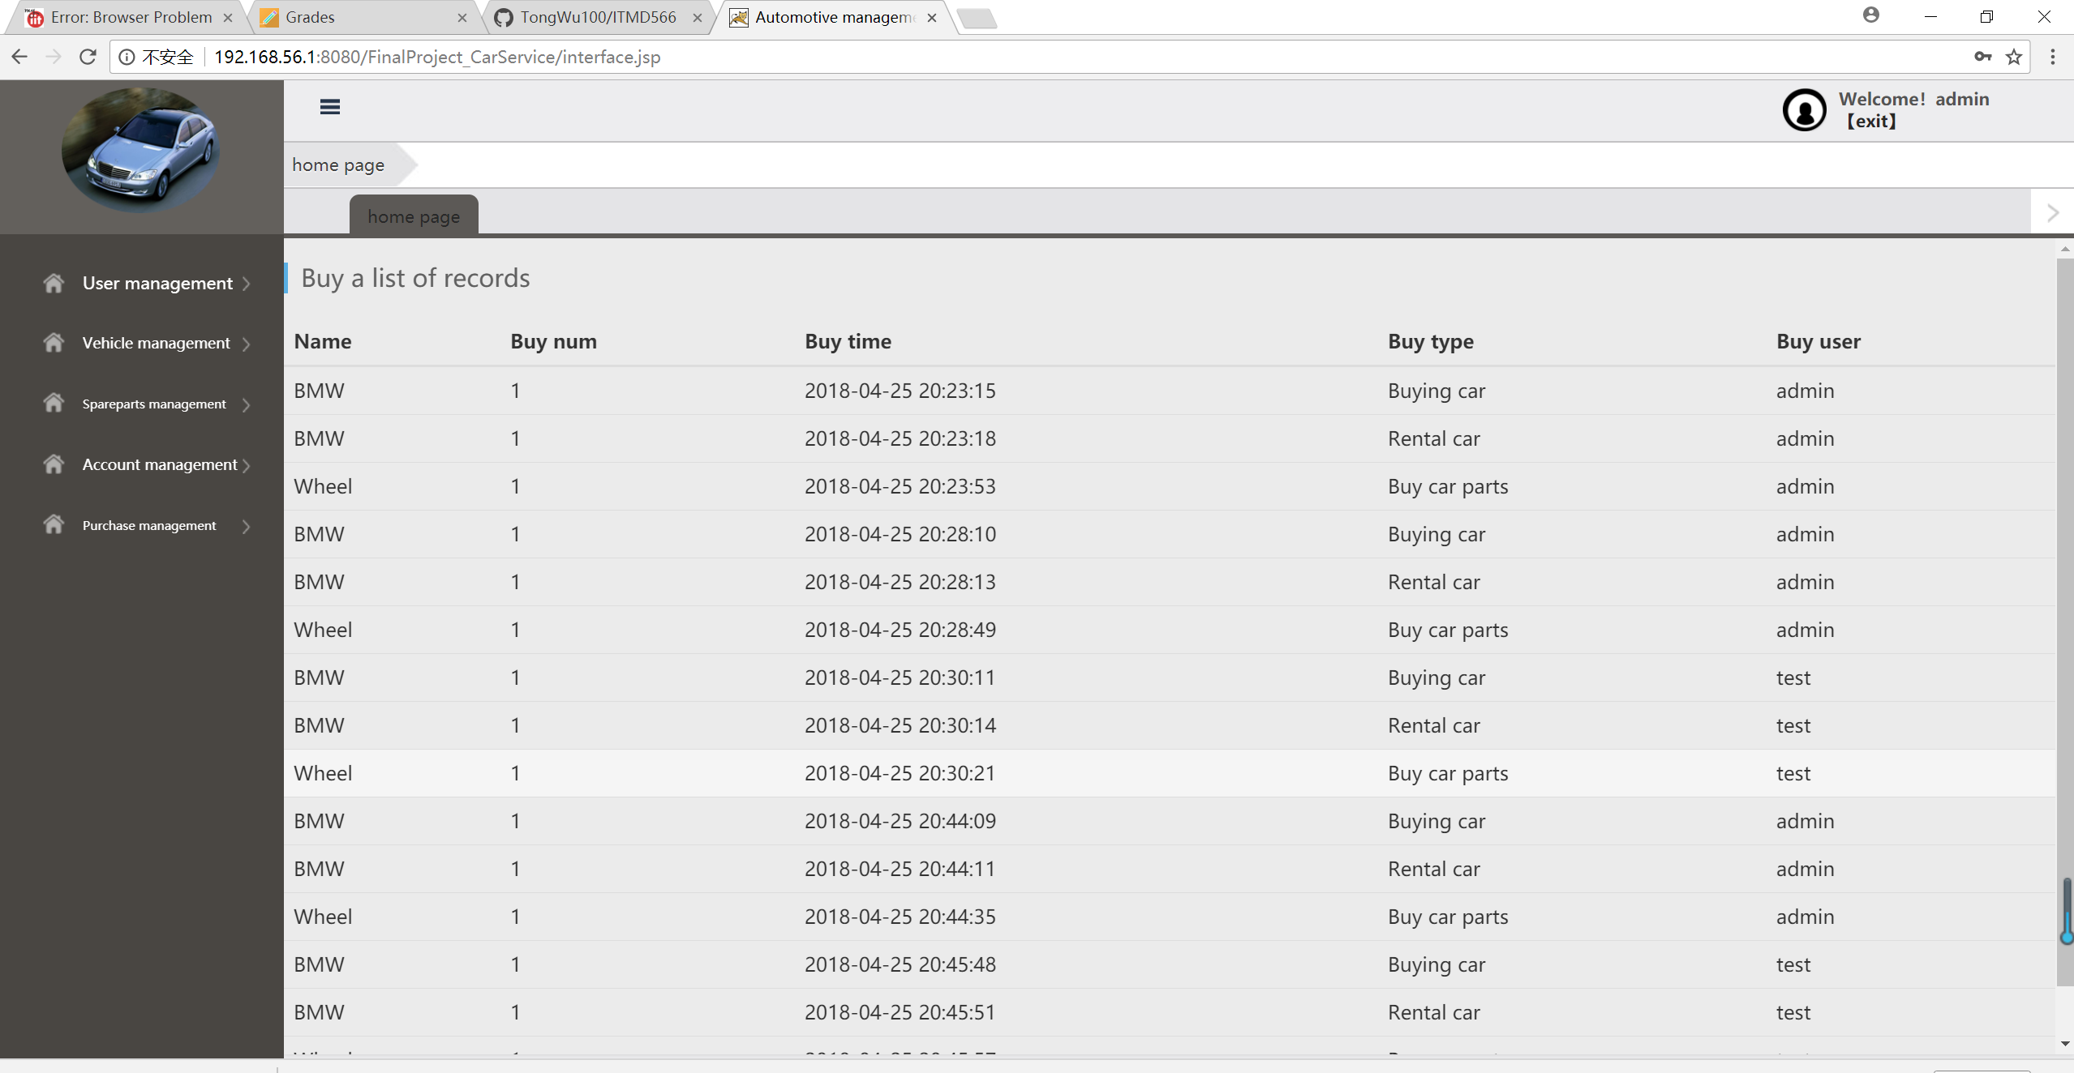
Admin check transaction history

Slide 10
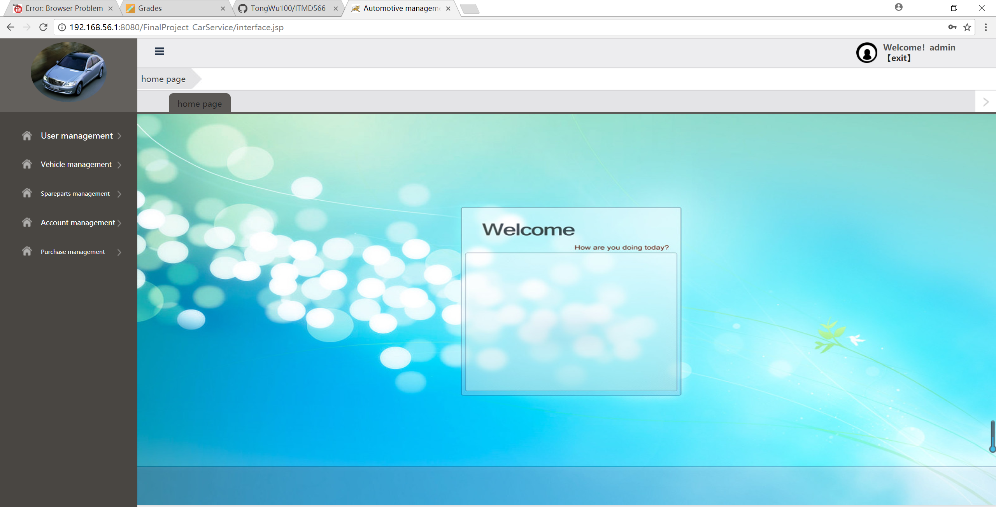
Customer login

Slide 11
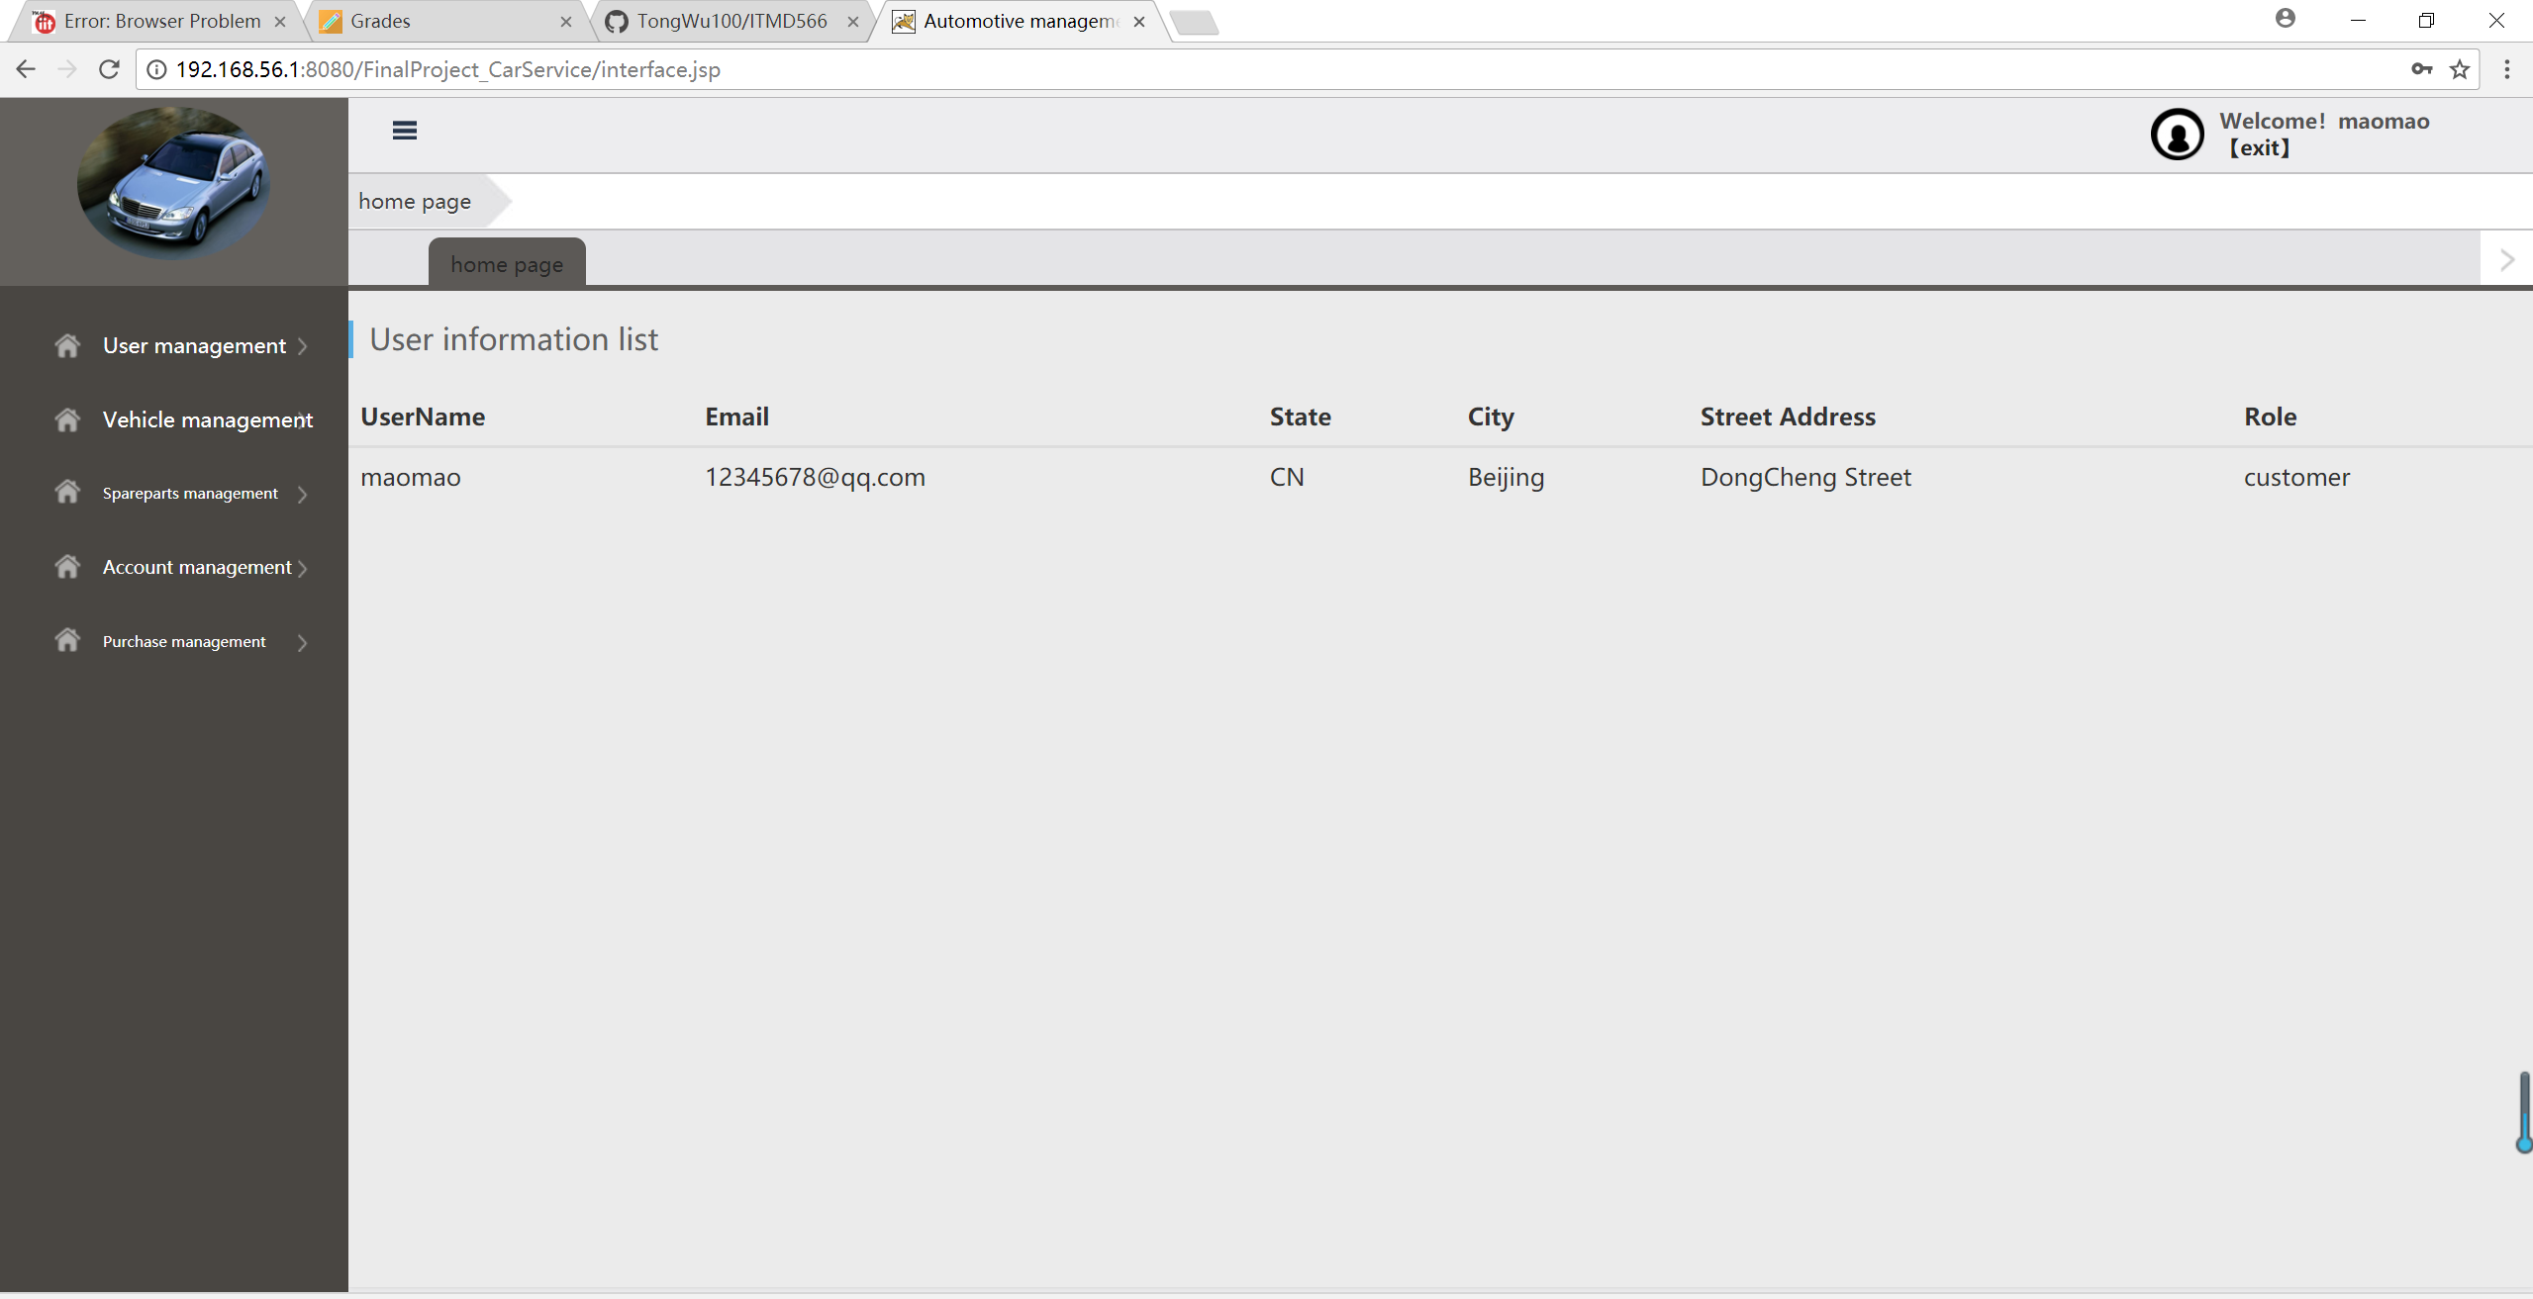
Customer check own information

Slide 12
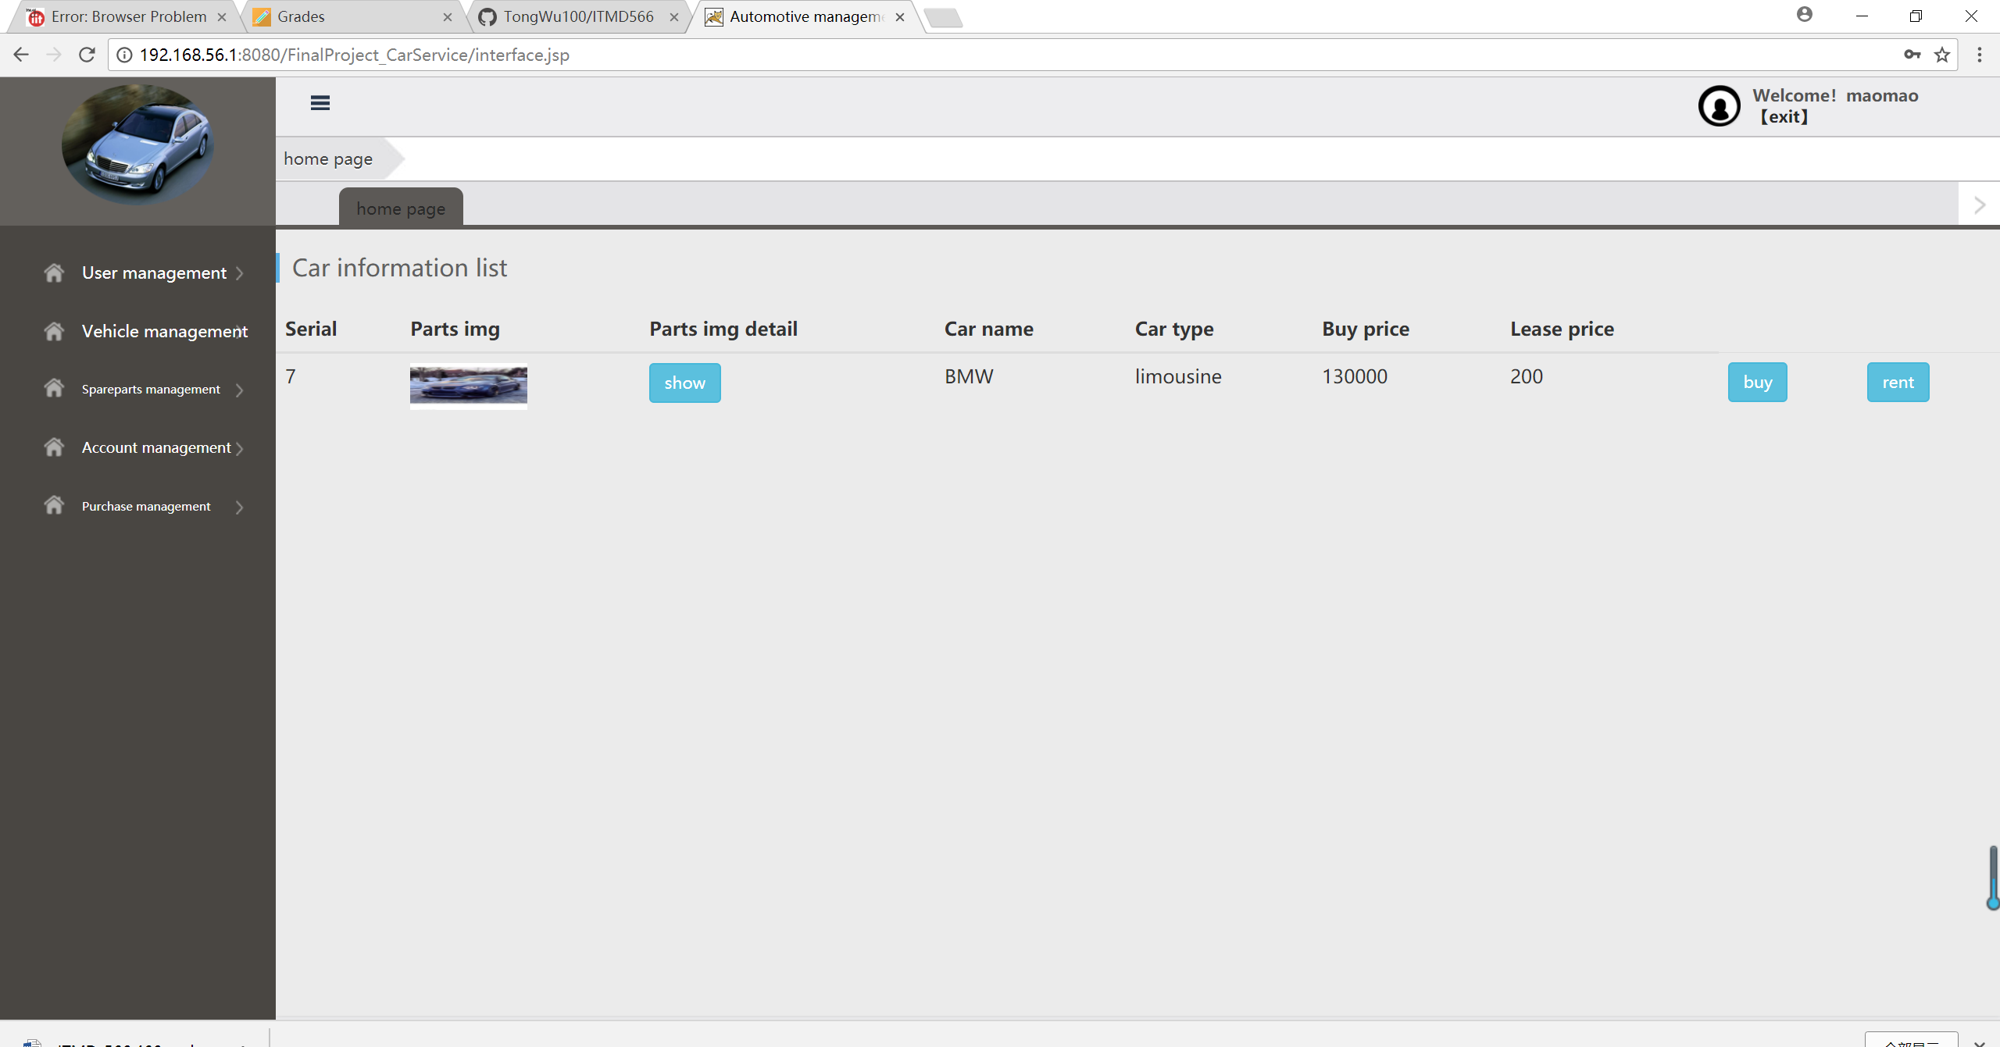
Customer buy or rent a car

Slide 13
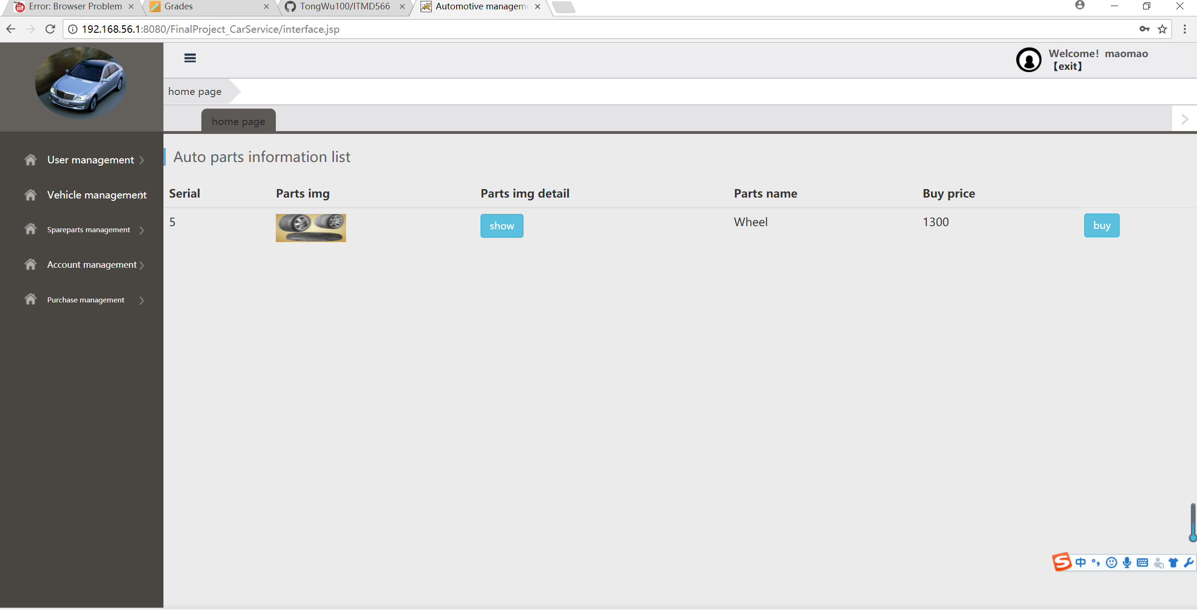
Customer buy or rent wheel

Slide 14
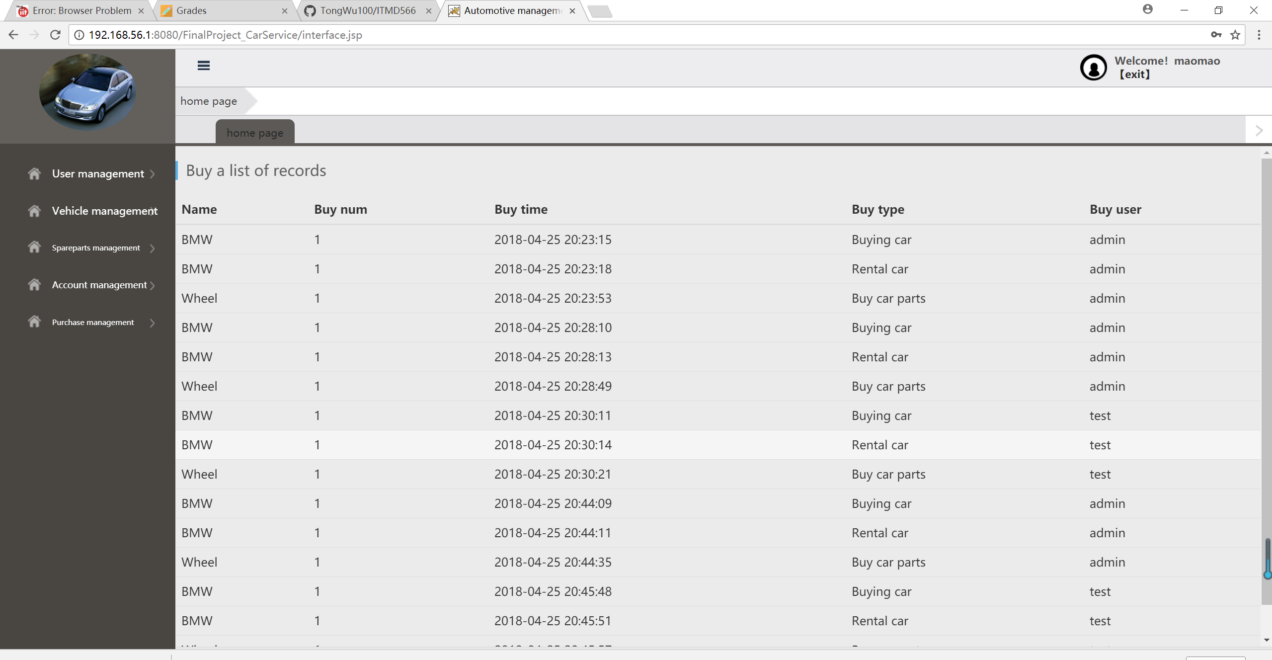
Customer check transaction history

Slide 15
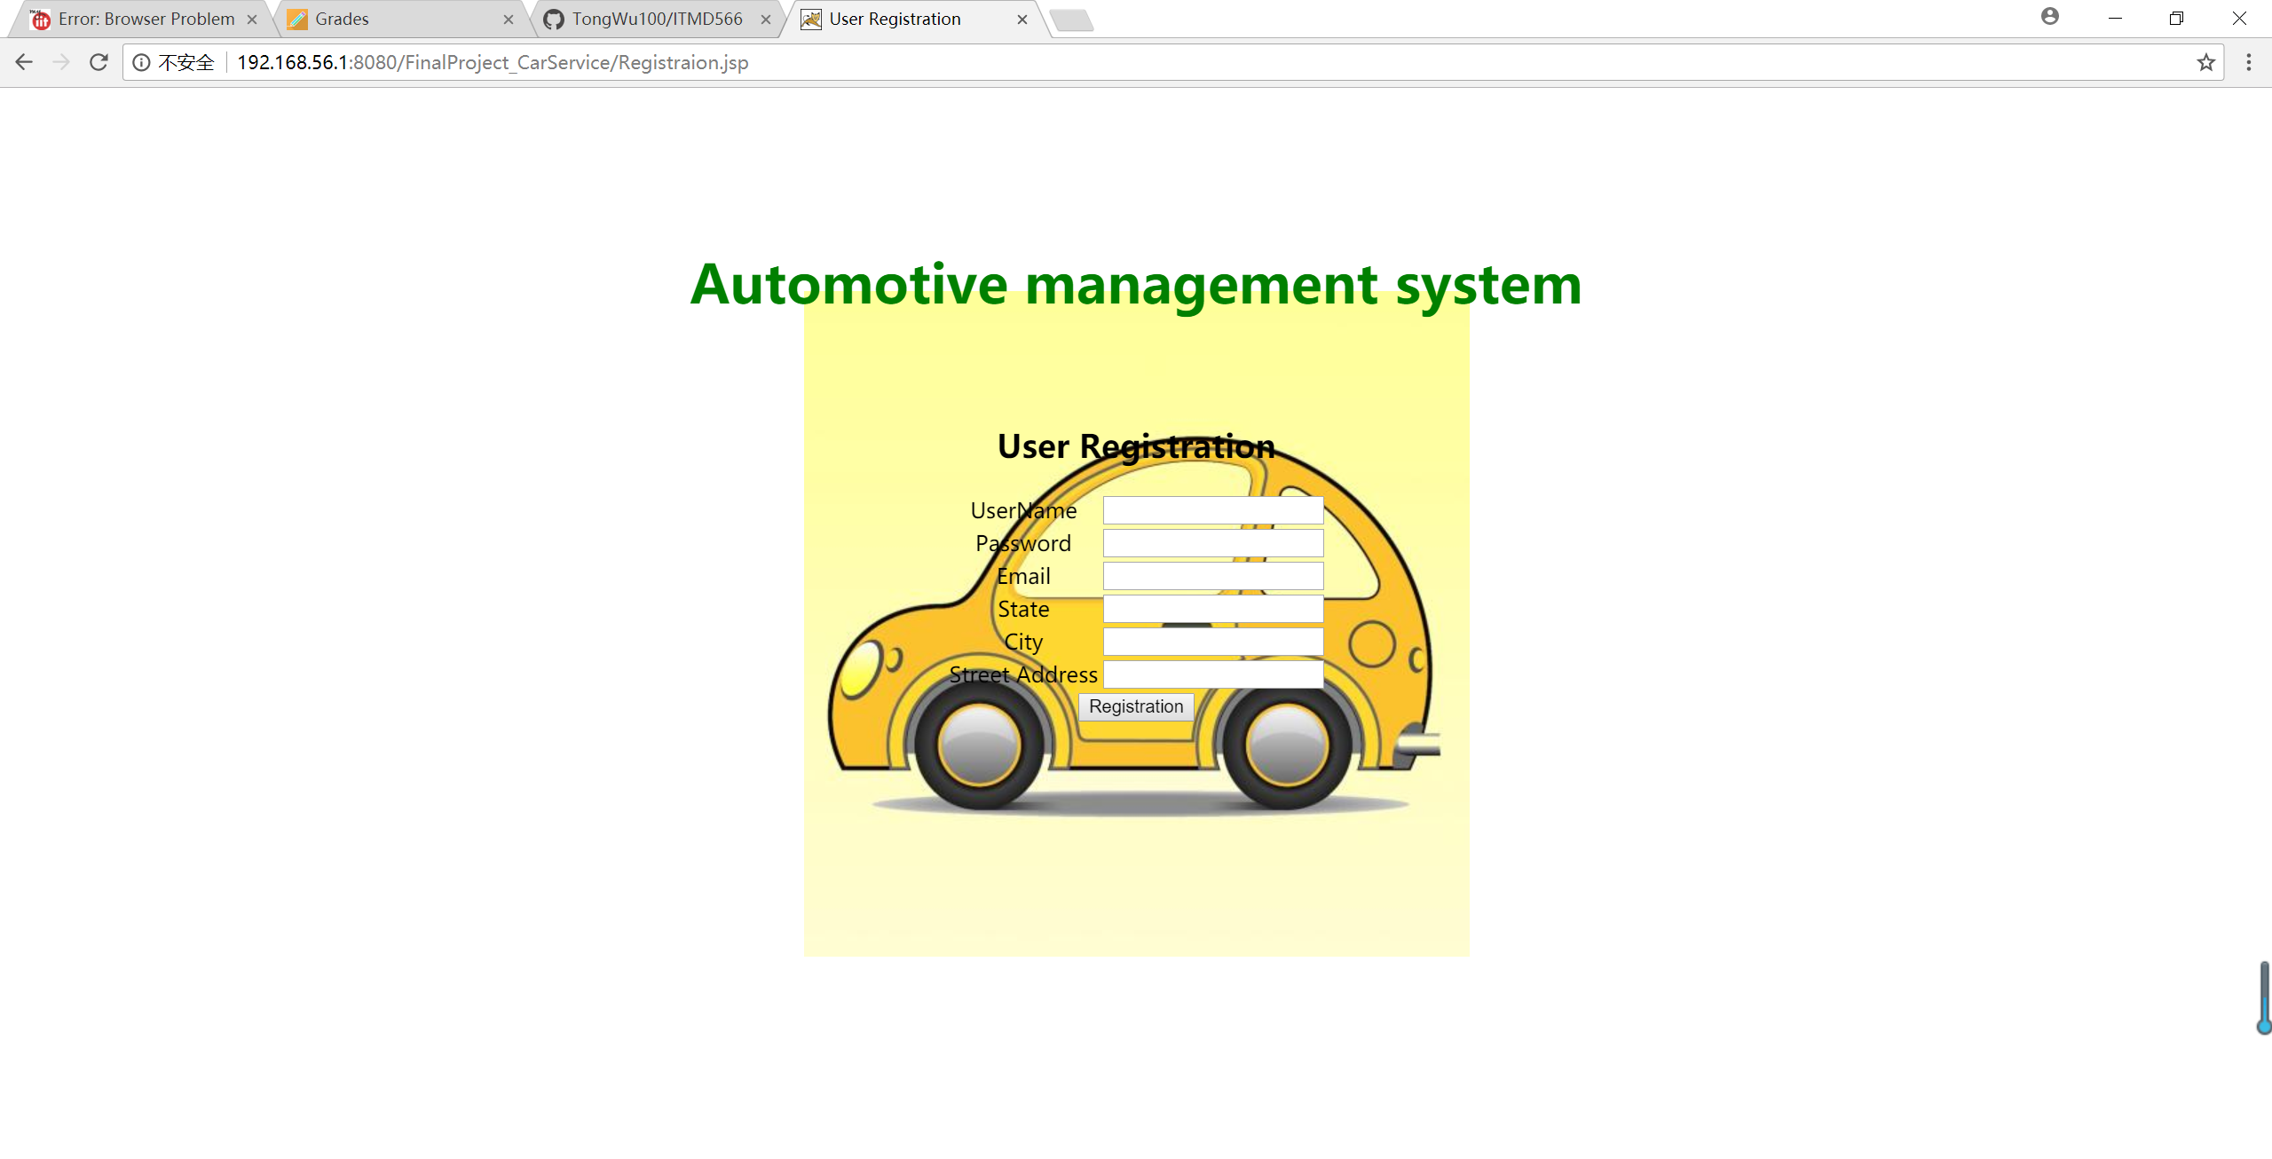
User Registration

Slide 16
Thank you so much for watching my application

